Slide 1

X-ray Analysis for Purification Process of Synthesized Multi-Walled Carbon Nanotubes
by Chemical Vapor Deposition
Firas H. Abdulrazzak*, Shahad K Esmail*, Halimah A. Dawod*, Ahmed M. Abbas**
and Mustafa K. K. Almaliki
*Department of Chemistry, College of Education for Pure Science, Diyala University, IRAQ
**Department of Chemistry, College of Education for Pure Science, Baghdad University IRAQ

Slide 4
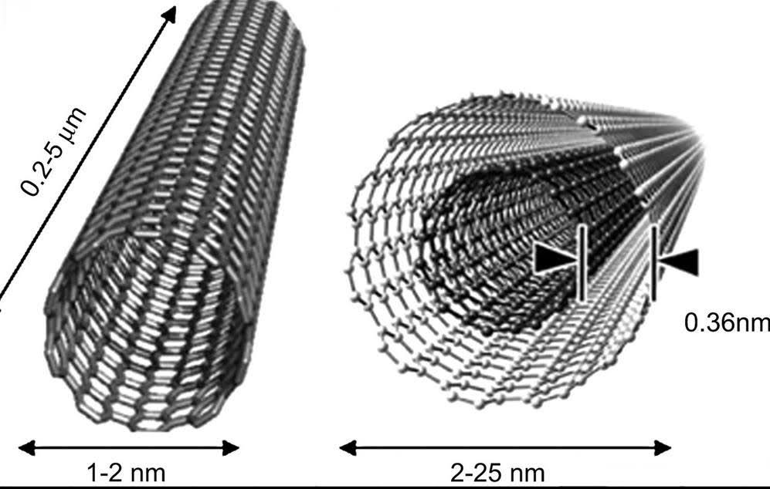

Slide 5
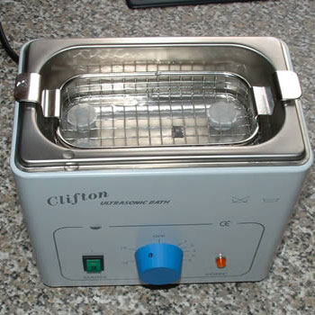
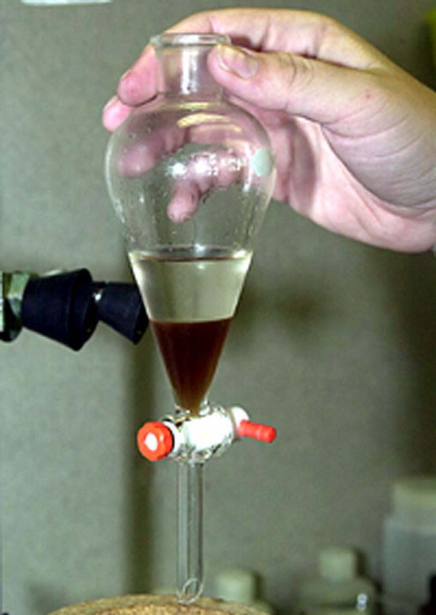

Slide 7
Si
Si
Ca
C
Ca
Ca
C
Ca

Slide 10
اعمل كما متوفر لديك وانفق قليلا من اجل منشور يستحق ان يكتب فية اسمك

Slide 11


